Slide 1
Machine learning for income imputation (American Housing Survey)
Jayne Yoo

Slide 2
Motivation
Target: various government institutions, consulting firms interested in nation wide income level, international organizations and academic scholars
Income Nonresponse
Response Error in Income Source Reports
Response Error in Income Amount Reports
Cognitive Factors in Income Reporting
Data: American Housing Survey (AHS)

Slide 3
American Housing Survey (AHS)
The survey provides up-to-date information about the quality and cost of housing in the United States and major metropolitan areas. The survey also includes questions about:
the physical condition of homes and neighborhoods,
the costs of financing and maintaining homes, and
the characteristics of people who live in these homes

Slide 4
Missing and partial reporters
 | Non-missing or Non partial reports |  | Missing or Partial reports
 | Frequency | Percent | Frequency | Percent
Total | 51185 | 81.01 | 12000 | 18.99
Home ownership | 42455 | 73.88 | 12000 | 19.62
1: Owned or being bought by someone in your household | 25376 | 40.16 | 7596 | 12.02
2: Rented | 16511 | 32.82 | 4232 | 6.7
3: Occupied without payment of rent | 568 | 0.9 | 172 | 0.9
Household head age
1: <25 | 10,074 | 96.1 | 412 | 3.93
2: >=25 & <45 | 14,553 | 84.8 | 2,604 | 15.18
3: >=45 & <65 | 16,099 | 78.9 | 4,300 | 21.08
4: >=65 | 10,459 | 69.1 | 4,684 | 30.93
Source: AHS 2019

Slide 5
Missing and partial reporters
Source: AHS 2019

Slide 6
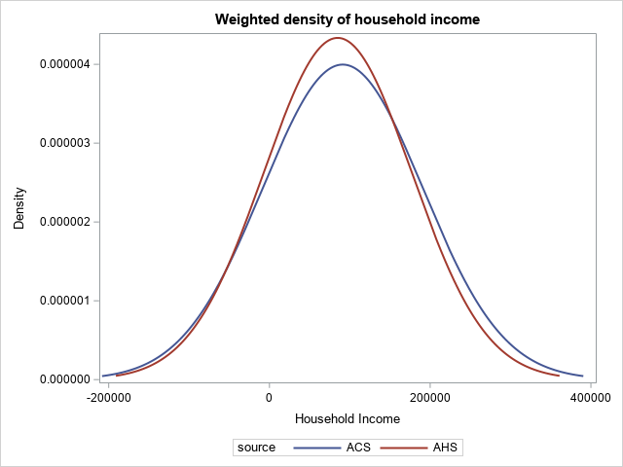
Difference with largest survey data in the U.S.
Source: American Community Survey, American Housing survey, 2019

Slide 7
Machine learning and income imputation
Existing method:
OLS regression using demographic and housing cost information
New solution:
Machine learning has more prediction power with better identification strategy

Slide 8
Project timeline
Before the semester
Analyze data to find the patterns of non-response or partial reports
First 5 weeks
Application of machine learning to obtain predicted income amount
Next 3 weeks
Conduct various sensitivity test to examine the improvement of accuracy
Comparison with ACS microdata and aggregate income data from IRS

